Slide 1

Robot Operating system
Course Introduction
Lecturer: Dr. Bui Ha Duc
Dept. of Mechatronics
Email: ducbh@hcmute.edu.vn

Slide 2
Course Objectives
This course is designed to provide student with:
Understand robot middleware frameworks, with a focus on ROS 2 architecture, nodes, topics, services, actions, and QoS.
Develop robot communication and visualization pipelines using ROS 2 tools for data exchange, monitoring, and debugging.
Simulate robotic systems in virtual environments and integrate simulation with real robot control.
Implement robot control and task execution, including basic motion control and sensor integration.
Design and implement robotic applications for: Navigation, Perception, Manipulation
Deploy ROS 2-based applications on embedded platforms, considering real-time constraints and hardware limitations.

Slide 3
Course Outline
Introduction to Robot Middleware & ROS 2 Basics
ROS 2 Communication Mechanisms
ROS 2 Programming
Coordinate Frames & Robot Description
Visualization & Debugging Tools
Simulation with Gazebo
Robot Control
Robot Behavior Design
Deployment on Embedded Systems

Slide 4
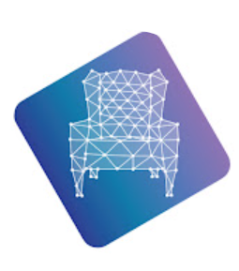
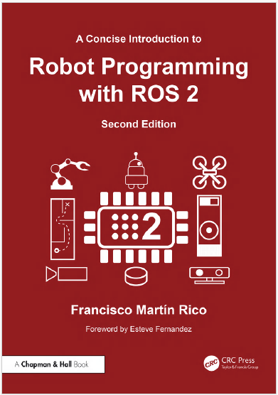
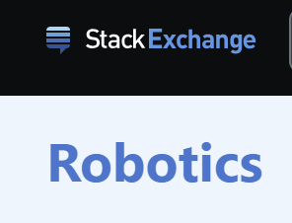

References
The Construct Robotics Institute
Youtube channel:
https://www.youtube.com/channel/UCt6Lag-vv25fTX3e11mVY1Q
RoboticsStackExchange
https://robotics.stackexchange.com
ROS2 Documentation
https://docs.ros.org
Source code:
https://github.com/fmrico/book_ros2

Slide 5

Assessments
Quizzes and Project – 50%
1 in-class Quiz
1 Project
Final Examination – 50%

